Slide 1
CoTaPP: Computational Thinking and Programming with Python
Module 7: Data Structures
2 March 2022

Slide 2
Previous data types
Atomic:
  int (7)
  float (2.5)
  bool (False)
Collections:
  str (“apple”)

Slide 3
str as a collection
“apple” = “a”, “p”, “p”, “l”, “e”

Slide 4
str as a collection
“apple” = “a”, “p”, “p”, “l”, “e”
len(“apple”) → 5
len(5) → TypeError

Slide 5
Lists
myList = [1,3,True,6.5]

Slide 6
Lists
myList = [1,3,True,6.5]
Ordered → [1,2] ≠ [2,1]

Slide 7
Lists
myList = [1,3,True,6.5]
Ordered → [1,2] ≠ [2,1]
Mutable →
  MyList[1] = 5
  print(MyList) → [1,5,True,6.5]

Slide 8
Lists
myList = [1, 3, True, 6.5]
Ordered → [1, 2] ≠ [2, 1]
Mutable →
  MyList[1] = 5
  print(MyList) → [1, 5, True, 6.5]
Non-unique → [1, 1, True, 6.5]

Slide 9
Lists
myList = [1, 3, True, 6.5]
Iterable →
  for el in myList:
  print(el)
  → 1
  3
  True
  6.5

Slide 10
Operations on lists
myList = [4, 1]
Name | Operator | Example
Indexing | [] | myList[0] → 1
Concatenation | + | myList + [2] → [4, 1, 2]
Repetition | * | myList * 2 → [4, 1, 4, 1]
Membership | in | 1 in myList → True
Length | len | len(myList) → 2
Slicing | [:] | myList[1:2] → [1]

Slide 11
Methods for lists
myList = [4, 1]
Name | Use | Returns | myList after
append | myList.append(2) | None | [4, 1, 2]
insert | myList.insert(0, 2) | None | [2, 4, 1]
pop | myList.pop(0) | 4 | [1]
sort | myList.sort() | None | [1, 4]
reverse | myList.reverse() | None | [1, 4]
index | myList.index(4) | 0 | [4, 1]
count | myList.count(1) | 1 | [4, 1]
remove | myList.remove(4) | None | [1]

Slide 12
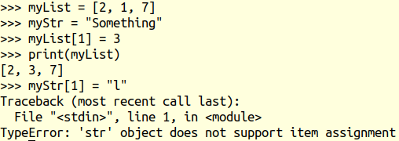
Mutability

Slide 13
Tuples
Ordered

Slide 14
Tuples
Ordered
Immutable

Slide 15
Tuples
Ordered
Immutable
Non-unique

Slide 16
Tuples
Ordered
Immutable
Non-unique
Iterable

Slide 17
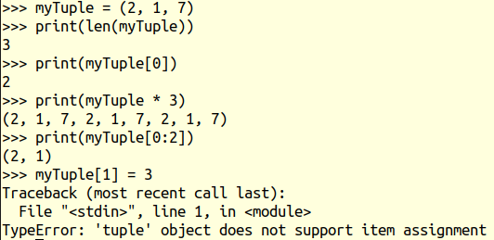
Tuples

Slide 18
Sets
Unordered
Mutable
Unique
Iterable

Slide 19

Sets: Unordered

Slide 20

Sets: Unique

Slide 21
Set Operations
Symbol | Name | Example
| | Union | {2, 3} | {3, 4} → {2, 3, 4}
& | Intersection | {2, 3} & {3, 4} → {3}
- | Difference | {2, 3} – {3, 4} → {2}
^ | Symmetric Difference | {2, 3} ^ {3, 4} → {2, 4}
<= | Subset | {2, 3} <= {3, 4} → False {2, 3} <= {2, 3, 4} → True
Union |
Difference -
Intersection &
Symmetric Difference ^

Slide 22
Set Operations
Symbol | Name | Example
| | Union | {2, 3} | {3, 4} → {2, 3, 4}
& | Intersection | {2, 3} & {3, 4} → {3}
- | Difference | {2, 3} – {3, 4} → {2}
^ | Symmetric Difference | {2, 3} ^ {3, 4} → {2, 4}
<= | Subset | {2, 3} <= {3, 4} → False {2, 3} <= {2, 3, 4} → True
A
B
B
A
A <= B –>False
A <= B –>True

Slide 23
Set Methods
Symbol | Name | Explanation
add | aset.add(item) | Insert item into aset
remove | aset.remove(item) | Remove item from aset
pop | aset.pop() | Remove a random element from aset
clear | aset.clear() | Remove all elements from aset

Slide 24
Dictionaries
Unordered
Mutable
Unique Keys
Iterable

Slide 25
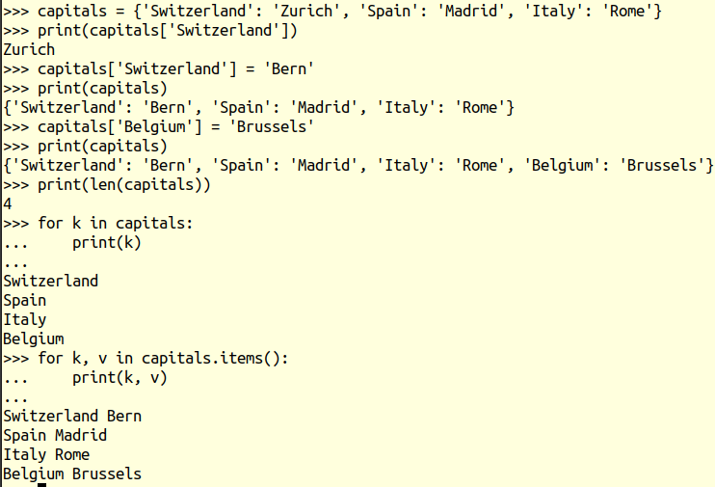
Dictionaries
capitals = {‘Switzerland’: ‘Zurich’, ‘Spain’: ‘Madrid’, ‘Italy’: ‘Rome’}

Slide 26

Dictionaries: Unordered

Slide 27
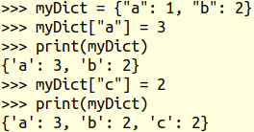
Dictionaries: Unique Keys

Slide 28
Dictionary Operations
capitals = {‘Switzerland’: ‘Bern’, ‘Spain’: ‘Madrid’, ‘Italy’: ‘Rome’}
Operator | Use | Example1 | Example2
[] | capitals[k] | capitals[‘Spain’] → ‘Madrid’ | capitals[‘Netherlands’] → KeyError
in | key in capitals | ‘Spain’ in capitals → True | ‘Madrid’ in capitals → False
del | del capitals[key] | del capitals[‘Spain’] → remove (‘Spain’, ‘Madrid’) entry | del capitals[‘Netherlands’] → KeyError

Slide 29
Dictionary Methods
capitals = {‘Switzerland’: ‘Bern’, ‘Spain’: ‘Madrid’, ‘Italy’: ‘Rome’}
Operator | Use | Return value | Type
keys | capitals.keys() | ‘Switzerland’, ‘Spain’, ‘Italy’ | dict_keys
values | capitals.values() | ‘Bern’, ‘Madrid’, ‘Rome’ | dict_values
items | capitals.items() | (‘Switzerland’, ‘Bern’), (‘Spain’, ‘Madrid’), (‘Italy’, ‘Rome’) | dict_items

Slide 30
Mixed-Type Collections
aList = [2, 2.5, True, “something”]
aSet = {2, 2.5, True, “something”}
aTuple = (2, 2.5, True, “something”)
aDict = {3: "t",
2.5: False,
"something": 42,
True: "t"}

Slide 31
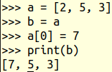
Copy vs Reference
Assigning a value by reference

Slide 32
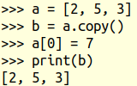
Copy vs Reference
Assigning a value by reference
Assigning a copy of the original object

Slide 33
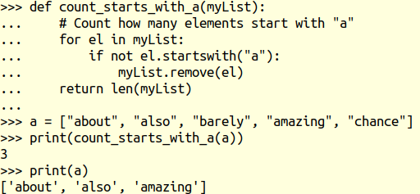
Calling Methods with References

